Slide 1


Java Travel
Julius danes nugroho
Suci rahmadhani
1nap2

Slide 2
PURPOSE
To search many passengers used Java Travel to destination to going some places easier than other transportation.

Slide 3
SYSTEM ANALYSIS
Java Travel appeared since 2010, is located at Center Jakarta. Java Travel is a transportation facilitate the community in achieving a particular destination or city with fast, convenient and very affordable price. Equipped with very convenient facilities, full air conditioning, as well as trained riders.
Java Travel has many advantages and has many discounts for loyal customers of Java Travel

Slide 4
Flowchart

Slide 5
procedure

Slide 6
Main menu

Slide 7
Destination before and arrive

Slide 8
Check : jarak jadwal harga kursi

Slide 9
Check distance

Slide 10
Check jadwal

Slide 11
Check price

Slide 12
Check chair

Slide 13
Check detail

Slide 14
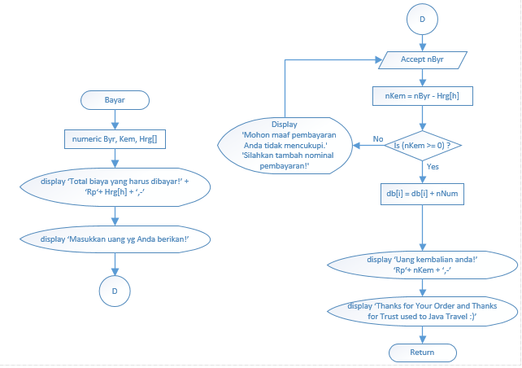
Payment

Slide 15

PSEUDOCODE

Slide 16
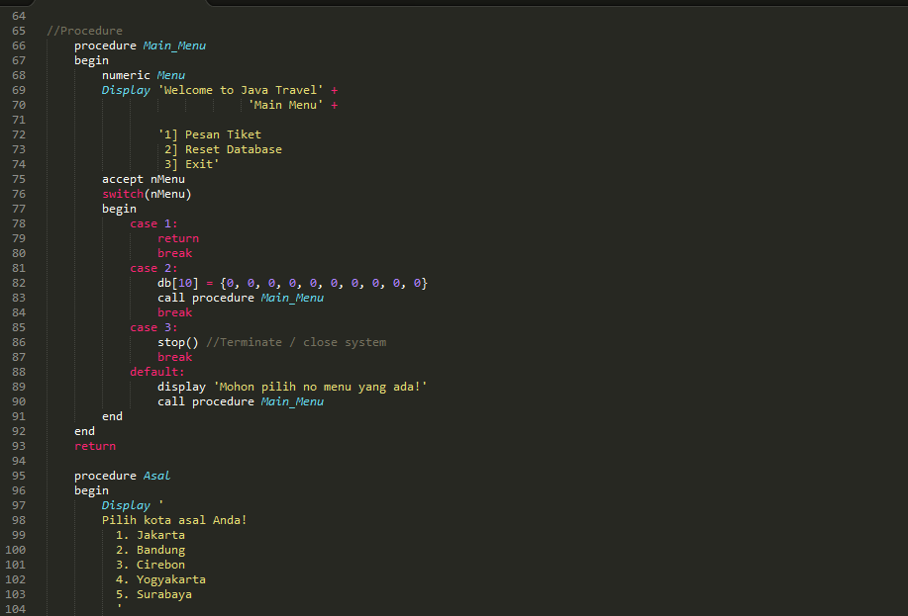
Procedure main menu

Slide 17

Procedur asal dan tujuan

Slide 18
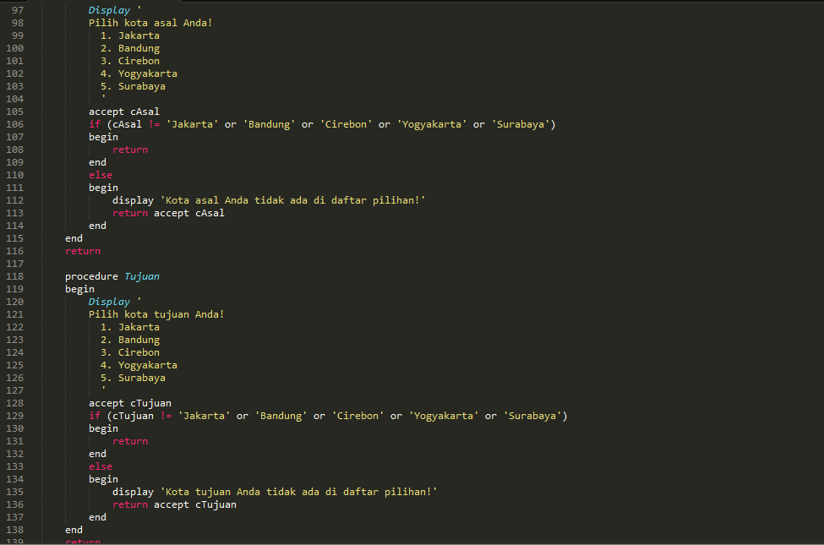

Slide 19
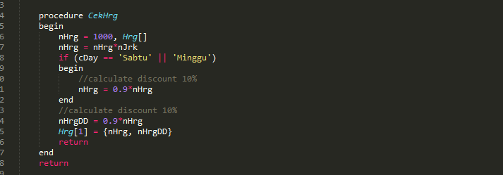
Procedure cek harga

Slide 20
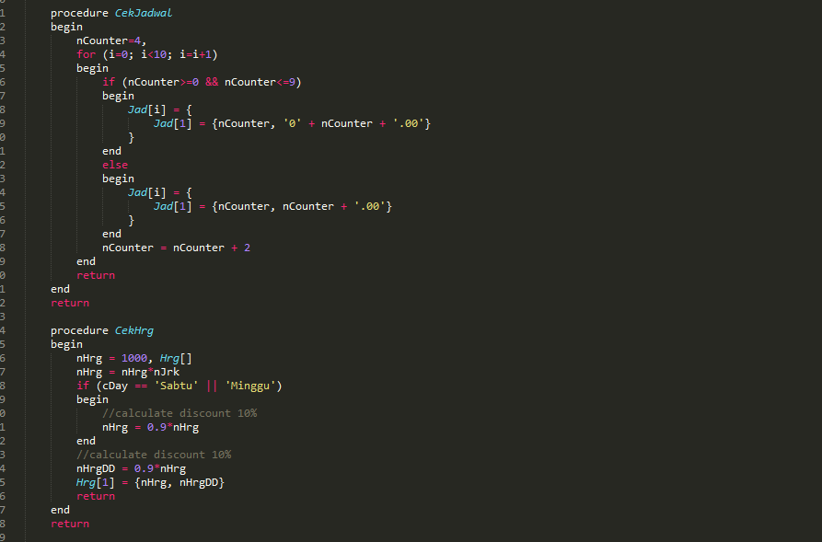
CHeCk jadwal AND PRICE

Slide 21
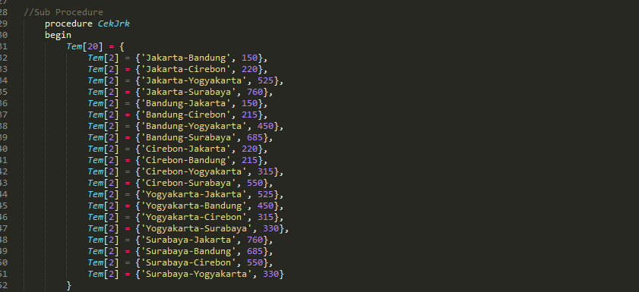
Check DISTANCE

Slide 22
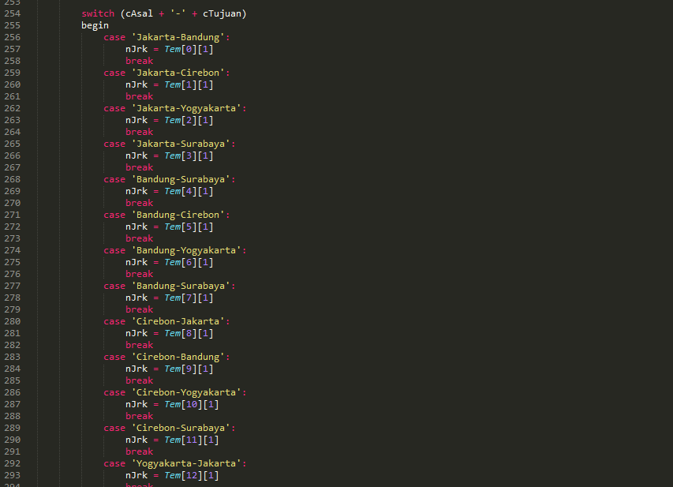

Slide 23
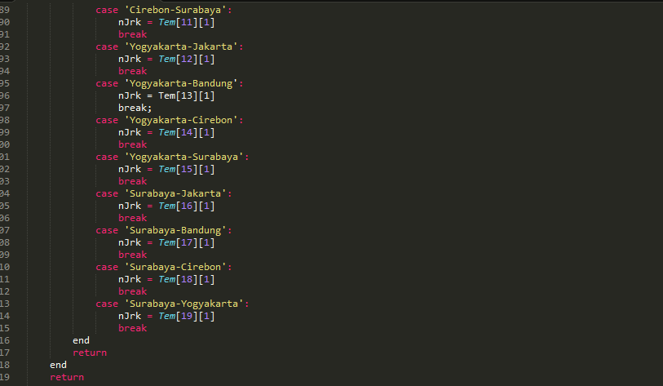

Slide 24
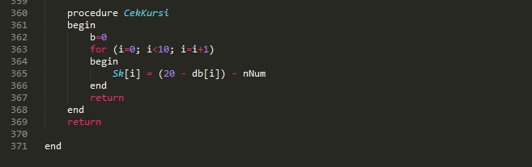
Check chairs

Slide 25
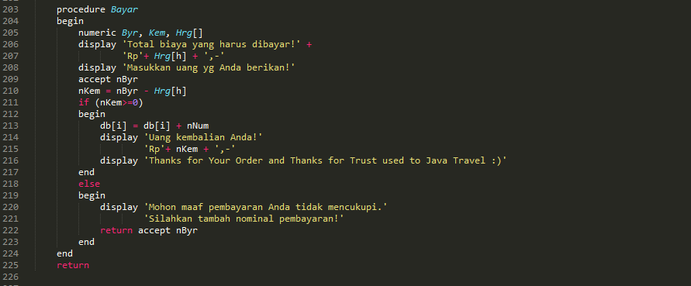
pembayaran

Slide 26
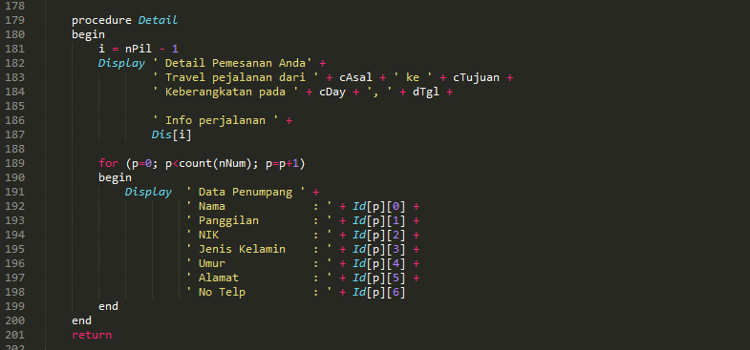
Detail pemesanan

Slide 27

Check pemesanan tickets

Slide 28
Dry run table

Slide 29
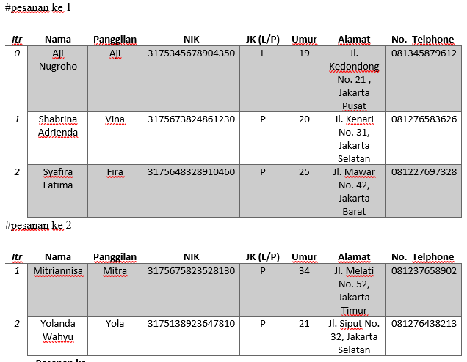
Id pemesanan

Slide 30
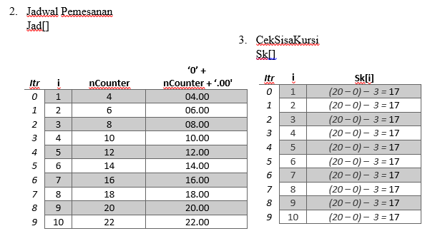
Jadwal pemesanan dan sisa kursi

Slide 31
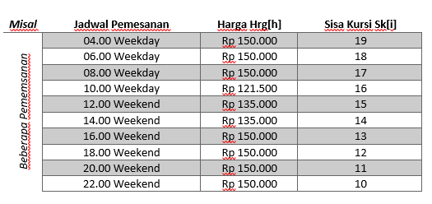
Jadwal pemesanan dan sisa kursi

Slide 32
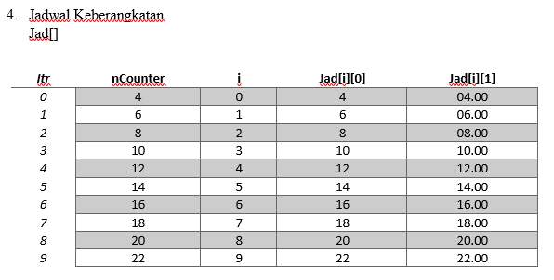
Keberangkatan

Slide 33
Thank you for attention ☺

